Slide 1
Expectation Maximization Algorithm

Slide 2
What is EM Algorithm In Machine Learning?
EM algorithm was proposed in 1997 by Arthur Dempster, Nan Laird, and Donald Rubin. It is basically used to find the local maximum likelihood parameters of a statistical model in case the latent variables are present, or the data is missing or incomplete.
The EM Algorithm follows the following steps in order to find the relevant model parameters in the presence of latent variables.
Consider a set of starting parameters in incomplete data.
Expectation Step
Maximization Step
Execute the step 2 and 3 until the convergence is met.
Notes:
Convergence – The concept of convergence in probability is based on intuition. Let’s say we have two random variables if the probability of their difference is very small, it is said to be converged. In this case, convergence means if the values match each other.

Slide 3
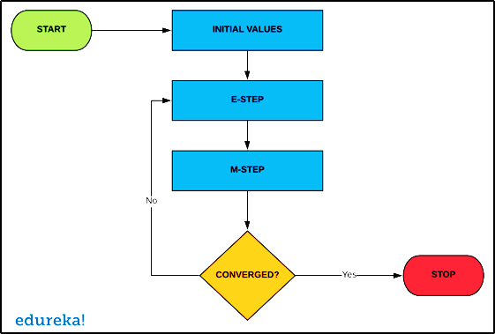
How Does It Work?
In the starting stage, a set of initial parameters is considered. A set of unobserved and incomplete data is given to the system with an assumption that the observed data is coming from a specific model.
E-STEP: In this step, we use the observed data to estimate missing or incomplete data. It is basically used to update the variables.
M-STEP: is used to complete the data generated in the E-STEP. This step basically updates the hypothesis.
It is checked whether the values are converging or not. If the values match, then we do nothing, else we will continue with step 2 and 3 until the convergence is met.

Slide 4
Advantages
It is guaranteed that the likelihood will increase with each iteration.
During implementation, the E-Step and M-step are very easy for many problems.
The solution for M-Step often exists in closed form
Disadvantages
EM algorithm has a very slow convergence.
It makes the convergence to the local optima only.
EM requires both forward and backward probabilities.

Slide 5
Applications
EM Algorithm is often used in data clustering in Machine Learning and computer vision.
It is also used in natural language processing.
The EM algorithm is used for parameter estimation in mixed models and quantitative genetics.
It is used in psychometrics for estimating item parameters and latent abilities of item response theory models.
Some other applications include medical image reconstruction, structural engineering, etc.

Slide 6
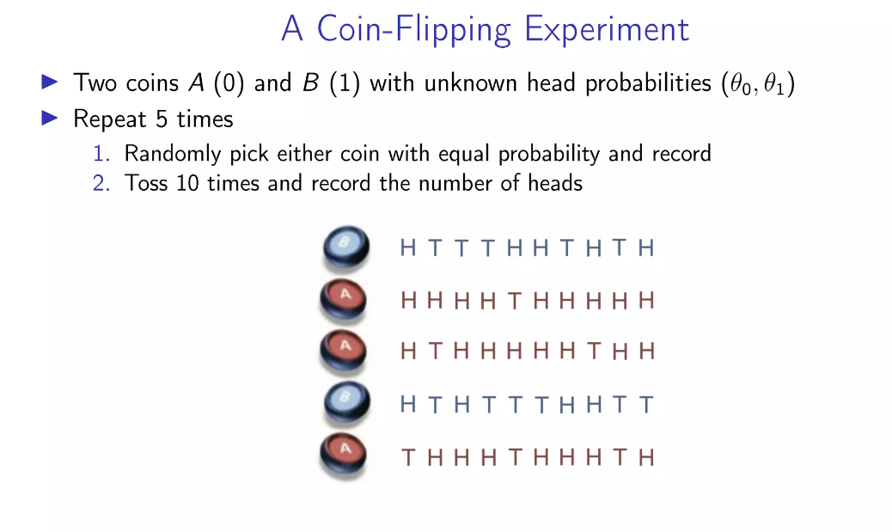

Slide 7
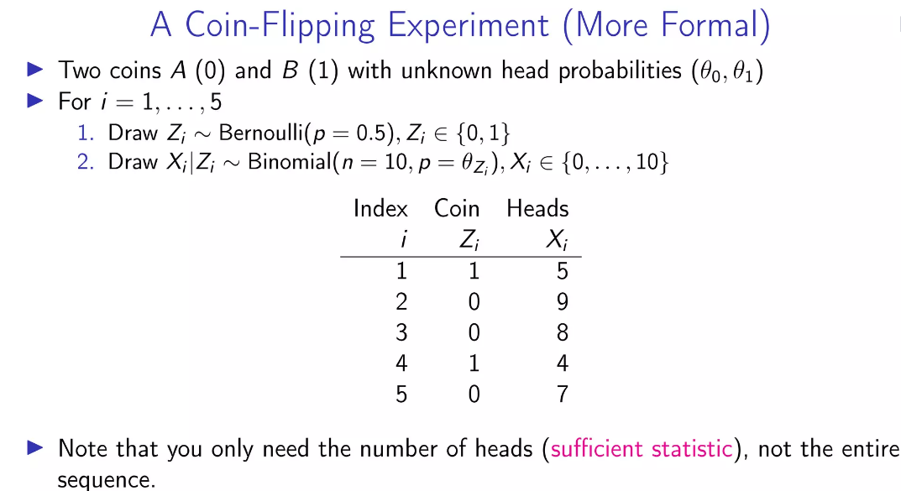

Slide 8
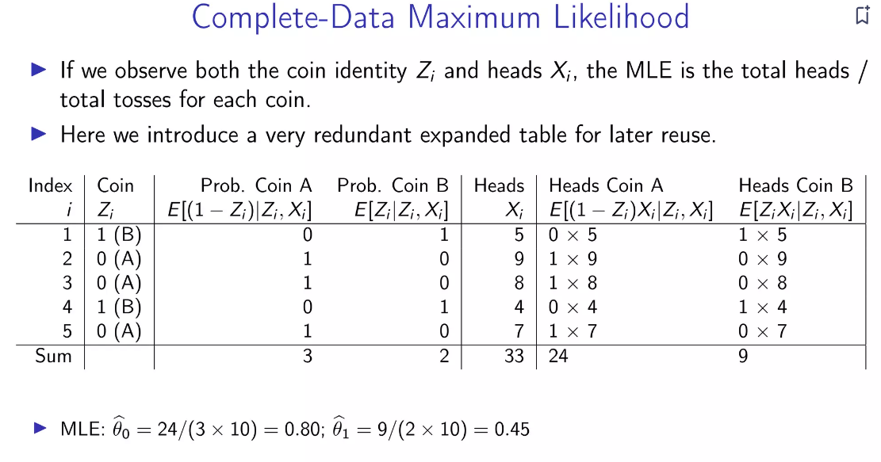

Slide 9
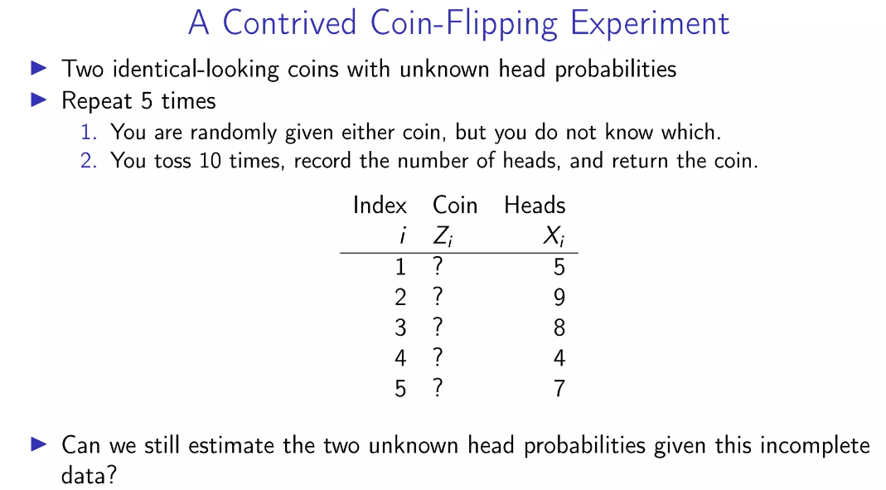
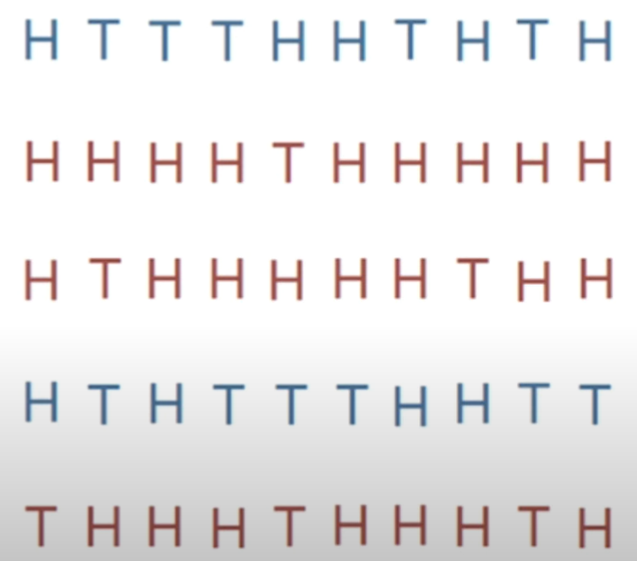

Slide 10
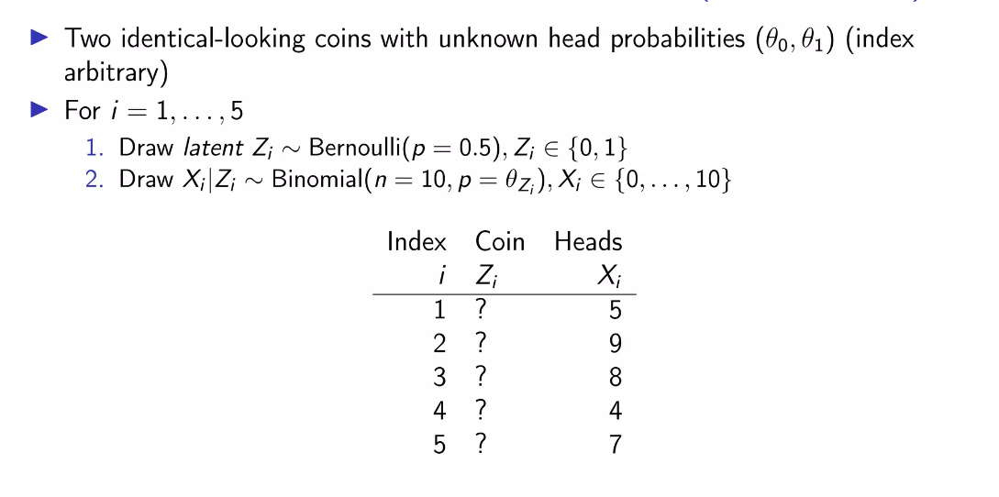

Slide 11
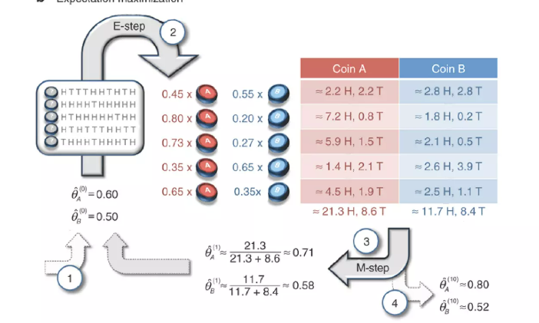

Slide 12
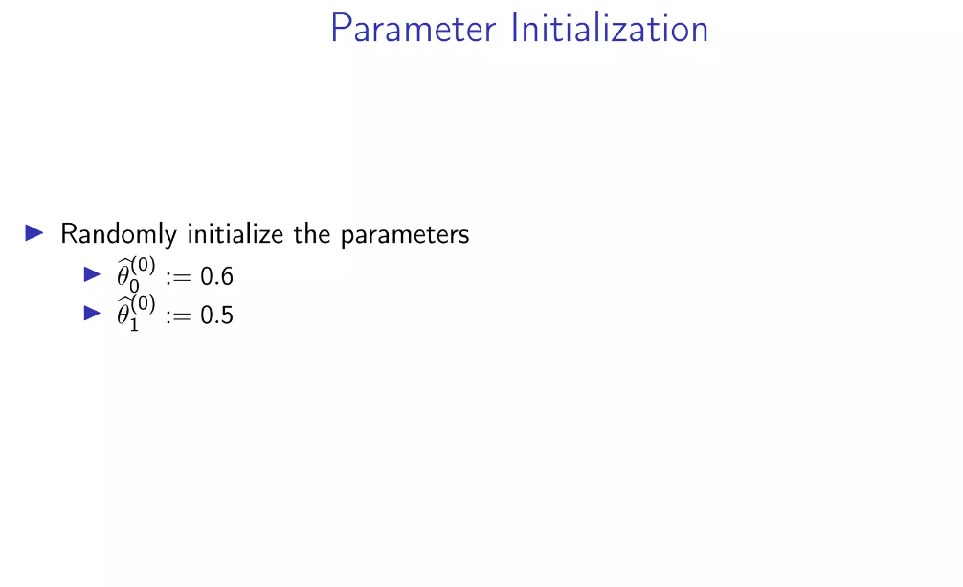

Slide 13
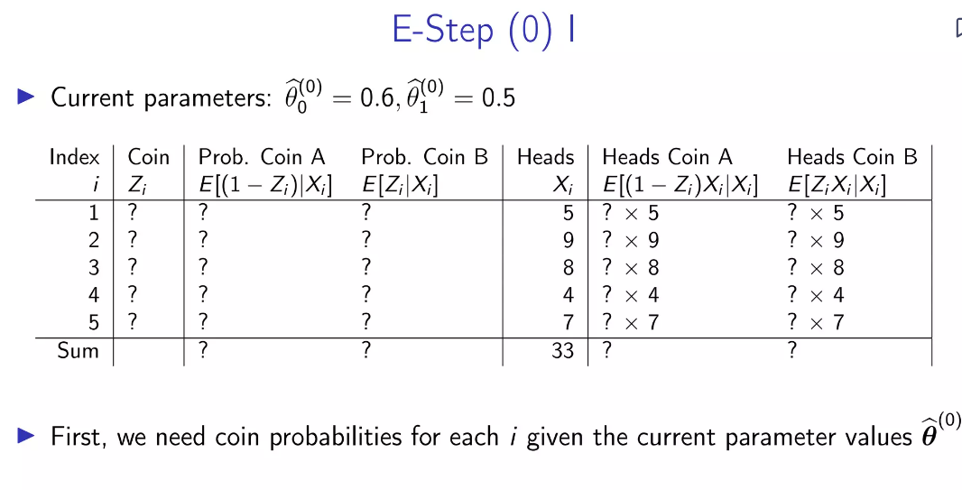

Slide 14

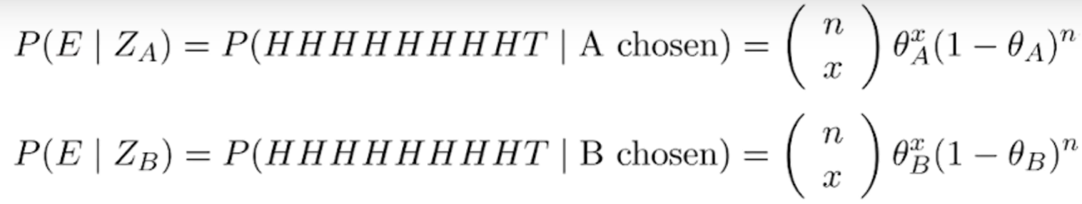
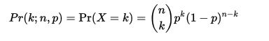
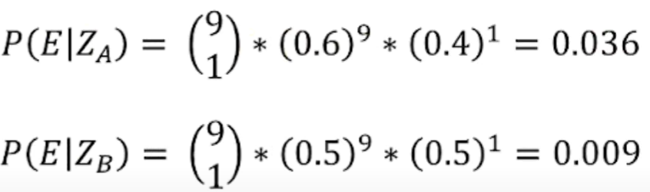

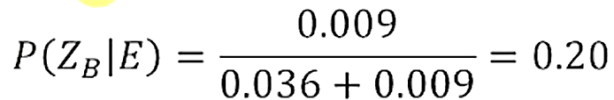


$$\left(\begin{matrix}10 \\ 9\end{matrix}\right)$$
probability of 9 heads given coin A
$$\left(\begin{matrix}10 \\ 9\end{matrix}\right)$$
probability of 9 heads given coin B
probability of coin A given 9 heads
probability of coin B given 9 heads

Slide 15

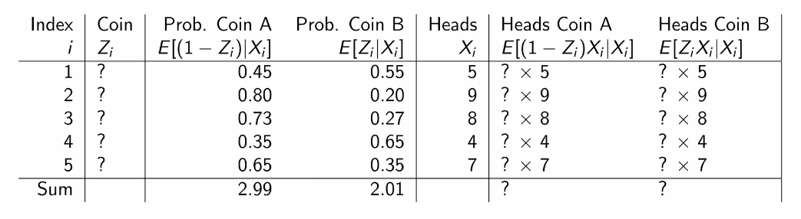

Slide 16
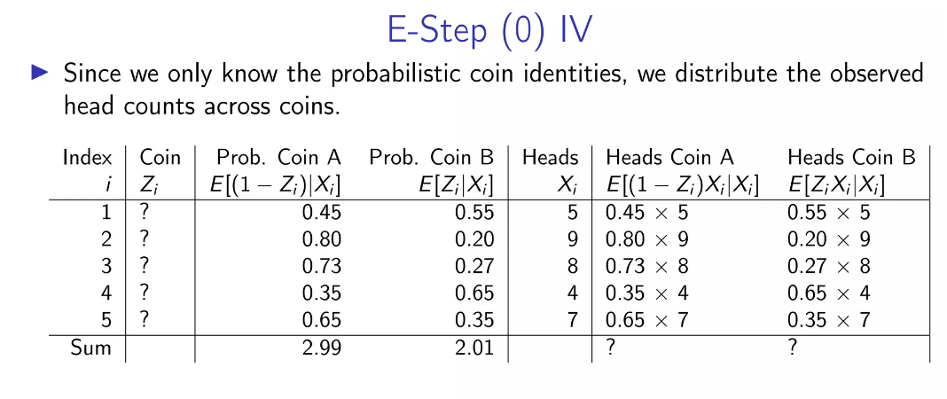

Slide 17
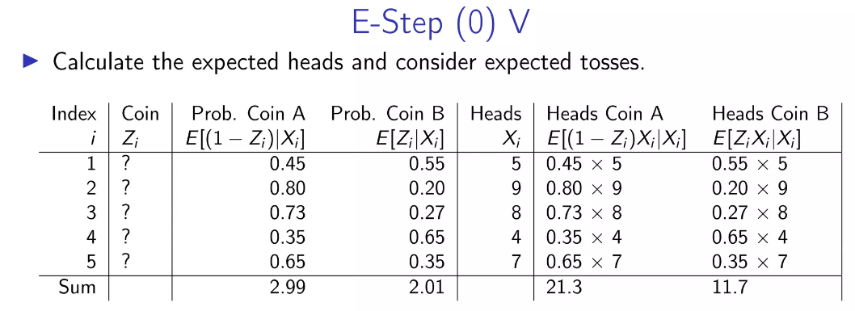

Slide 18
